Slide 1
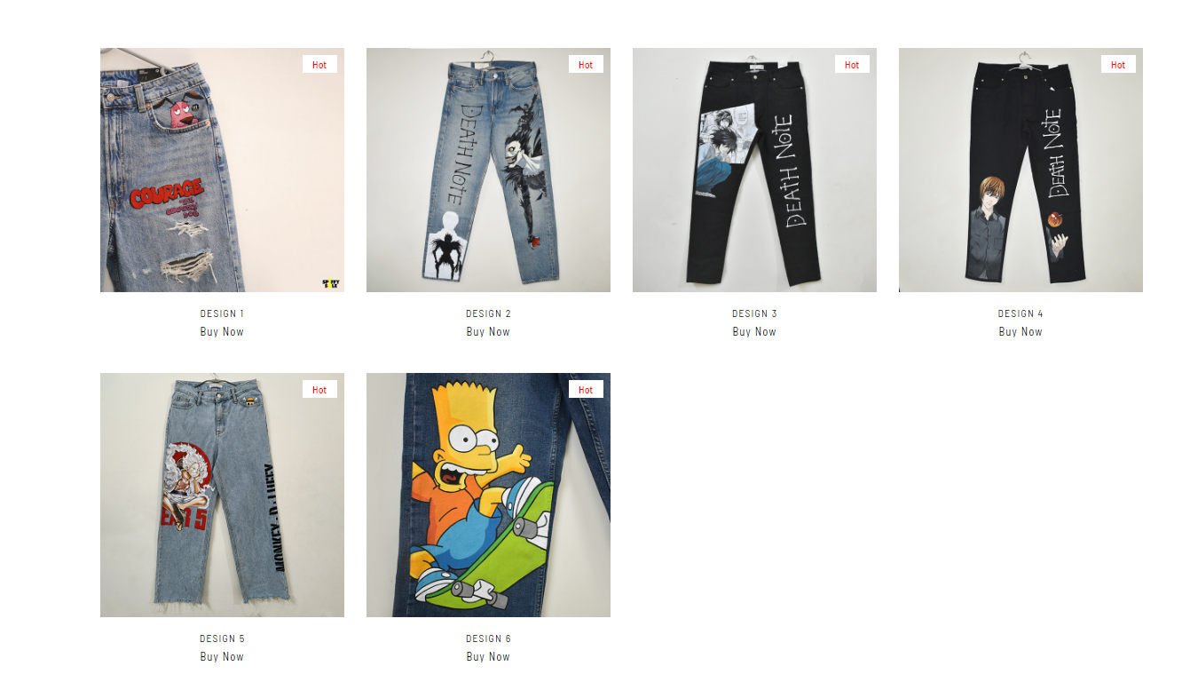
Custom Courage Edition : Rs. 2,099
Death Note Ryuk Edition : Rs. 4,299
Death Note L Edition : Rs. 3,899
Light Yagami Edition : Rs. 3,699
Luffy Gear 5 Edition : Rs. 4,199
The Simpsons Edition : Rs. 2,999

Slide 2
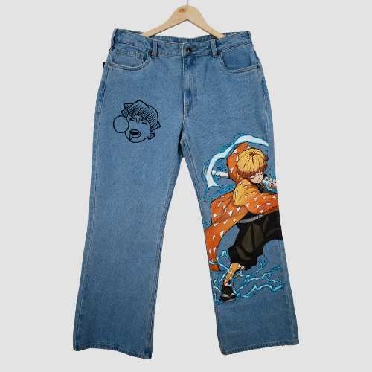
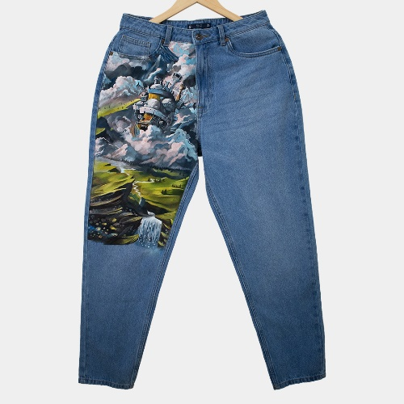
Custom Courage Edition : Rs. 2,099
Death Note Ryuk Edition : Rs. 4,299
Death Note L Edition : Rs. 3,899
Light Yagami Edition : Rs. 3,699
Luffy Gear 5 Edition : Rs. 4,199
The Simpsons Edition : Rs. 2,999

Slide 3
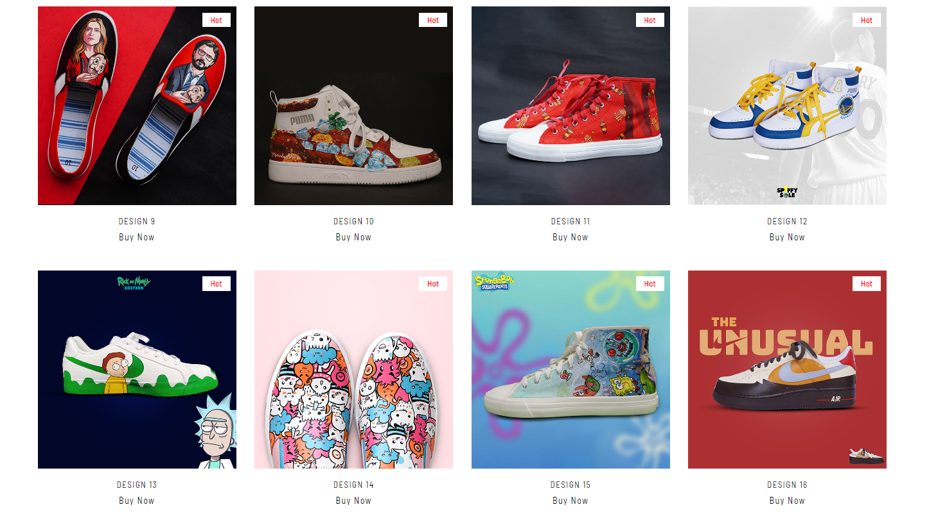
Remove
Cuba Libra Custom(Puma Rebound)
Netflix n Chill Custom: Rs. 4,099
Stephen Curry Custom (Puma Rebound): Rs. 5,299
Rick and Morty Custom 01 : Rs. ,3899
Doodle Monster Custom Slip-ons : Rs. 2,999
SpongeBob Squarepants Custom : Rs. 7,199
exclusive

Slide 4
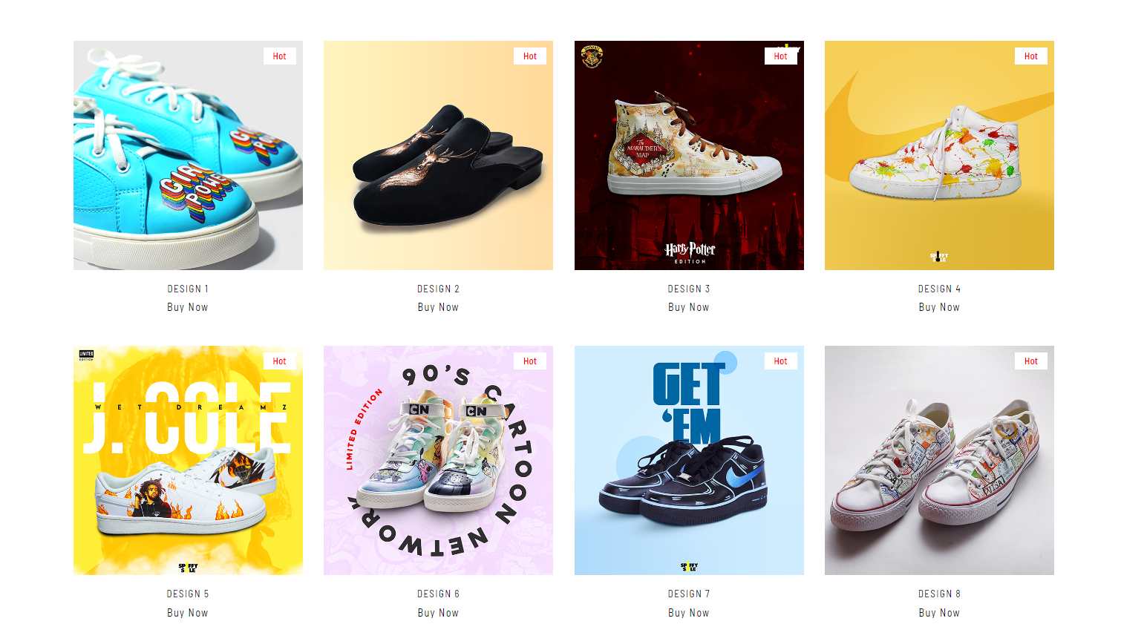
Girl Power
Custom : Rs. 3,999
Hello
Harry Potter Custom
(H&M High Top) : Rs. 3,999
exclusive
J Cole Custom (Nike Court Royale) : Rs. 4,899
Nike AF1 Black Midnight Sketchups : Rs. 3,999
Travel Stamp Custom Converse: Rs. 5,199
CN 90’s Custom 01: Rs. 5,499

Slide 5
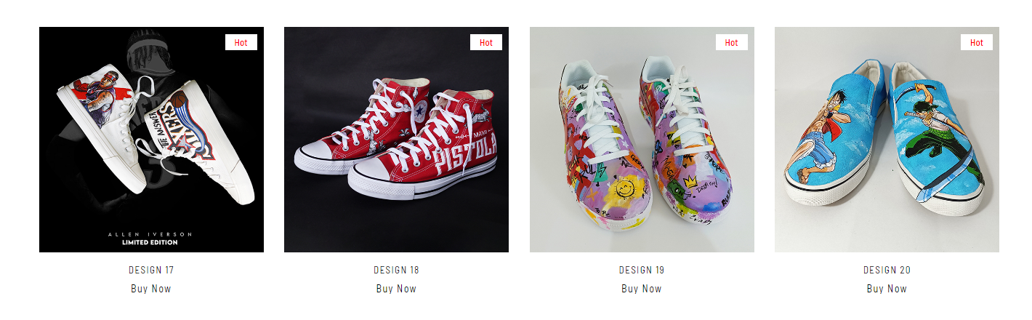
Nike Court Royale Graffiti Custom : Rs. 5,699
Luffy and Zoro (One Piece) Custom Slip-ons : Rs. 4,299
Allen Iverson Custom (H&M High Top) : Rs. 6,299
Exclusive

Slide 6
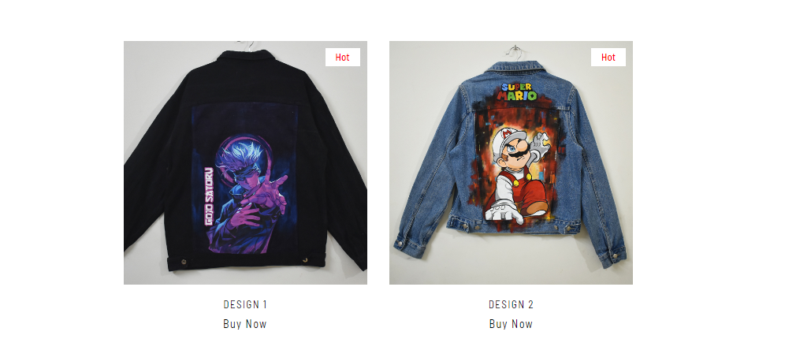
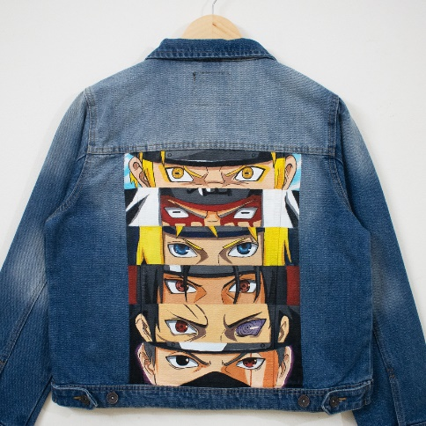
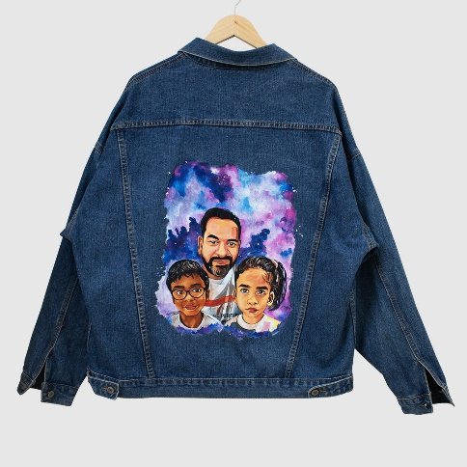
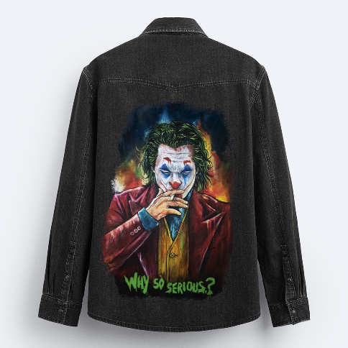
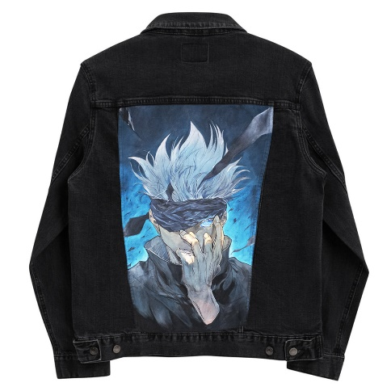
Custom Portraits
Naruto Shippuden
Rs. 5,499
Gojo Satoru
Rs. 5,399
Super Mario
Rs. 3,999
Joker Custom
Rs. 4,699
Gojo Satoru
Rs. 4,499

Slide 7
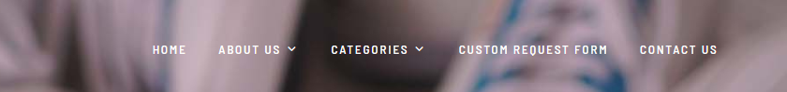

Current
Home
About Us
Categories
Design Your Own
Bulk Orders
Remove all
sub categories
Custom Shoes
Custom Jeans
Custom Jacket
Custom Totes
Our Exclusives
Quick Links
FAQs
Design your own
Bulk Orders
Remove the
Newsletter section
Current

Slide 8
FAQs
What’s Spiffy Sole all about?
At Spiffy Sole, we transform everyday sneakers, denim, and totes into bold, hand-painted statement that resonates your personal style.
2) What types of shoes or clothes can be customised?
We customize any shoes made from leather or canvas, while for clothing, we recommend denim and cotton shirts for the best results.
3) Does the paint come off?
No, the paint we use is highly durable and designed to last on leather, canvas, and fabric material. Plus, we provide a care instructions card so you
keep your customized pieces looking fresh – take care of those babies and they’ll last!
4) How is the total price of shoe/denim/totes determined?
The total price includes:
The complexity of the design, the amount of customization required, time and labour and the type of shoe or denim.
5) Do you require a deposit?
Yes, deposit is determined by the total price.
6) Is there a return policy?
Since each item is custom-made to your specifications, we unfortunately do not offer returns or exchanges. However, if there’s an issue with
your order,
please reach out to us and we’ll do our best to make it right!
7) How long does it take?
Time always depends on the design and the area coverage. Typically it takes 2 weeks from the time we finalize your design.
We’ll keep you updated every step of the way, so you know when to expect your custom creation! When possible we do offer rush hour orders.

Slide 9
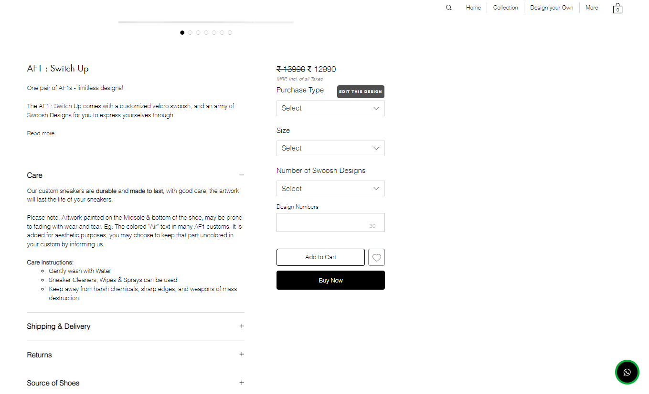
Reference From Current website

Slide 10
Content for Spiffy Sole
Cost Details
Starting at ₹1499/-Our pricing is based on the intricacy of the design and the area you want to customize. Whether it's your jeans, jacket, or sneakers, each piece is hand-painted to match your vision. For example, customizing the back pockets of jeans starts from ₹1499/-, while the front area customization starts from ₹1799/-. The larger the area or the more detailed the design, the price adjusts accordingly - making every customization truly one of a kind.
Note
At Spiffy Sole, every design is uniquely customized to meet our customers' specific demands and preferences. None of our designs are mass-produced – each piece is customised with individual attention to ensure it reflects the personal style and vision of our customers.
Purchase Tabs
Revamp My Jeans/Jacket/Shoes
Custom New Pair
Connect Now

